Slide 1
Defining problem statement
Problem Statement
An aviation company that provides domestic as well as international trips to the customers now wants to apply a targeted approach instead of reaching out to each of the customers. This time they want to do it digitally instead of tele calling. Hence, they have collaborated with a social networking platform, so they can learn the digital and social behaviour of the customers and provide the digital advertisement on the user page of the targeted customers who have a high propensity to take up the product. Propensity of buying tickets is different for different login devices. Hence, you have to create 2 models separately for Laptop and Mobile. [Anything which is not a laptop can be considered as mobile phone usage.] The advertisements on the digital platform are a bit expensive; hence, you need to be very accurate while creating the models.

Slide 2
Need of the study/project
This is a classification Problem and can be solved by building
The need of this Project is to assist company on boosting their sales of Booking tickets online by checking the Behaviour of the Customers and building a model such that the company can take decision on posting the digital advertisement for the Targeted Customers.

Slide 3
c) Understanding business/social opportunity
Social networking platform cand help us understanding digital and social behaviour of the customers and provide the digital advertisement on the user page of the targeted customers who have a high propensity to take up the product. Propensity of buying tickets is different for different login devices. Hence, you have to create 2 models separately for Laptop and Mobile. [Anything which is not a laptop can be considered as mobile phone usage.]

Slide 4
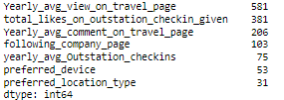
Checking Missing values report

Slide 5
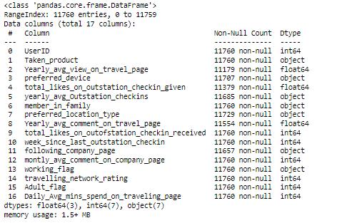
Information of data before Pre-Processing

Slide 6
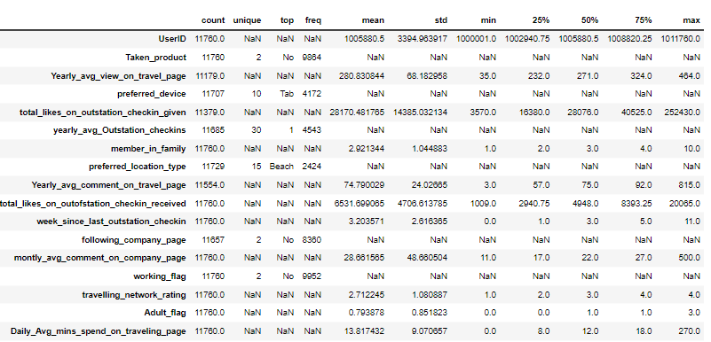
Description of data

Slide 7
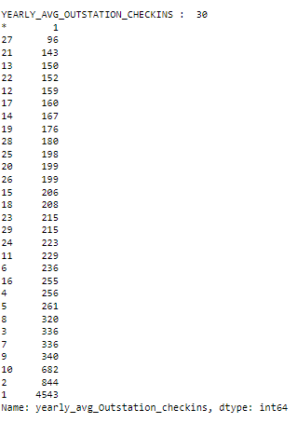
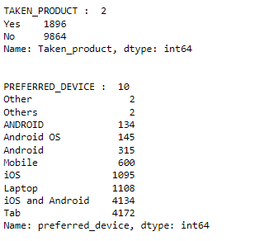
Visual inspection of data (rows, columns, descriptive details)
Unique values for categorical variables

Slide 8
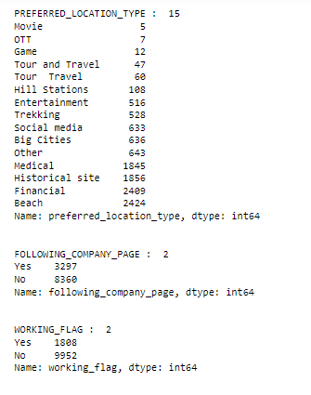
Unique values for categorical variables

Slide 9
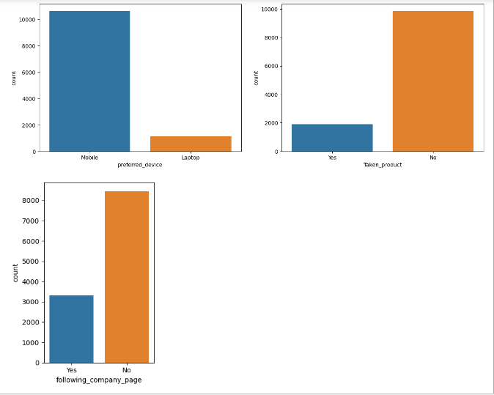
EDA Graphical Representation

Slide 10
Treating Missing values for Numerical Variables
Replace * values from yearly_avg_Outstation_checkins
Yearly_avg_view_on_travel_page has null values and has outliers so this is Treated by median values as the measure of Central tendency
total_likes_on_outstation_checkin_given has null values and has outliers so this is Treated by median values as the measure of Central tendency
Yearly_avg_comment_on_travel_page has null values and has outliers so this is Treated by median values as the measure of Central tendency

Slide 11
Treating Missing values for Catagorical Variables
following_company_page replace Null values by using mode functions as measure of central tendency.
preferred_device replace Null values by using mode functions as measure of central tendency.
preferred_location_type replace Null values by using mode functions as measure of central tendency.

Slide 12
Apply One Hot Encoding and Partitioning the data into train and test
Perform One Hot Encoding and in one hot encoding we use Drop to ensure that multiple columns created based on the levels of categorical variable are not included else it will result into multicollinearity . This is done to ensure that we do not land in to dummy trap.
Partitioning the data into train and test.Our Taget Variable is Taken_Product
X is all the Independent variables from the dataset excluding Target Variable(dependent variable)
Y will have only the Target Variable(dependent variable)

Slide 13
Balancing the Data
Balancing the Data can be done by Oversampling or Under sampling
In this case we are using SMOTE technique to balance the data by over sampling.

Slide 14
Handle Imbalanced Data
How we know the Data is Imbalanced?
When check the Target variable distribution In this case it is Taken_Product
From the below figure Our variable of Interest is ‘Yes’ but its has very less count compared with ‘No’ This indicates the data Imbalance
The number of classes before fit Counter({0: 6905, 1: 1327})
The number of classes after fit Counter({0: 6905, 1: 5178})
Note: Balancing of the data is done using SMOTE

Slide 15
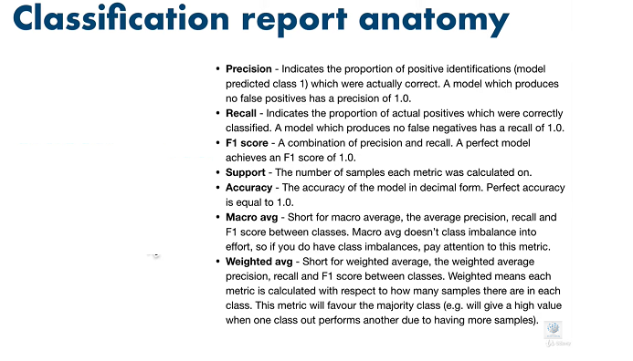

Slide 16
LDA Model on Imbalanced Data
Before Balancing the data
Model
Basic Model |  |  | Performance Matrix
LDA | Devices |  | Accuracy | F1 score | Precision | Recall | Roc Auc Score | Confusion Matrix
 | Mobile | Train | 0.8547 | 0.822 | 0.6527 | 0.211 | 0.5947 | [[6756 149]
 |  |  |  |  |  |  |  | [1047 280]]
 |  | Test | 0.8552 | 0.8249 | 0.6436 | 0.2285 | 0.6021 | [[2887 72]
 |  |  |  |  |  |  |  | [ 439 130]]
 | Laptop | Train | 0.8547 | 0.822 | 0.6527 | 0.211 | 0.5947 | [[6756 149]
 |  |  |  |  |  |  |  | [1047 280]]
 |  | Test | 0.8552 | 0.8249 | 0.6436 | 0.2285 | 0.6021 | [[2887 72]
 |  |  |  |  |  |  |  | [ 439 130]]

Slide 17
LDA Model Inferences
Inferences
True Positive : The number of correctly predicted positive instances from Mobile devices who has taken Product is 130 out of 569 Mobile Users
True Positive : The number of correctly predicted positive instances from Laptop devices who has taken Product is 130 out of 569 Users
Precison is 64 % for the for Mobile Users means that only 64% have been predicted correcly and reset Predictions are not correct
Precison is 64 % for the for Laptop Users means that only 64% have been predicted correcly and reset Predictions are not correct
Precision and recall is low so the Model is not performing good

Slide 18
Logistic Regression Model on Imbalanced Data
Basic Model |  |  | Performance Matrix
 | Devices |  | Accuracy | F1 score | Precision | Recall | Roc Auc Score | Confusion Matrix
Logistic Regression | Mobile | Train | 0.8384 | 0.7667 | 0.4118 | 0.0053 | 0.5019 | [[6895 10]
 |  |  |  |  |  |  |  | [1320 7]]
 |  | Test | 0.8387 | 0.7689 | 0.5 | 0.0123 | 0.505 | [[2952 7]
 |  |  |  |  |  |  |  | [ 562 7]]
 | Laptop | Train | 0.8389 | 0.7656 | 1 | 0.0008 | 0.5004 | [[6905 0]
 |  |  |  |  |  |  |  | [1326 1]]
 |  | Test | 0.8387 | 0.7652 | 0 | 0 | 0.5 | [[2959 0]
 |  |  |  |  |  |  |  | [ 569 0]]

Slide 19
Logistic Regression Model Inferences
This model is not fit for consideration as the precison is very poor

Slide 20
Decision Tree Model on Imbalanced data
Tree Model |  |  | Performance Matrix
Decision Tree | Devices |  | Accuracy | F1 score | Precision | Recall | Roc Auc Score | Confusion Matrix
 | Mobile | Train | 1 | 1 | 1 | 1 | 1 | [[6905 0]
 |  |  |  |  |  |  |  | [ 0 1327]]
 |  | Test | 0.9731 | 0.9731 | 0.9158 | 0.9174 | 0.9506 | [[2911 48]
 |  |  |  |  |  |  |  | [ 47 522]]
 | Laptop | Train | 1 | 1 | 1 | 1 | 1 | [[6905 0]
 |  |  |  |  |  |  |  | [ 0 1327]]
 |  | Test | 0.9748 | 0.9748 | 0.9211 | 0.9227 | 0.9537 | [[2914 45]
 |  |  |  |  |  |  |  | [ 44 525]]

Slide 21
Decision Model Inferences
Inferences
model has made no false positive predictions during training
A precision score of 100 in the training set could potentially be a sign of overfitting. Overfitting occurs when a model performs extremely well on the training data but fails to generalize well to unseen data.
model has memorized the training data instead of learning the underlying patterns. This model is not recommended
precision score of 100 in a training model should be viewed with caution

Slide 22
Random Forest Model Ensemble Technique on imbalanced Data
Forest Model Ensemble Technique |  |  | Performance Matrix
 | Devices |  | Accuracy | F1 score | Precision | Recall | Roc Auc Score | Confusion Matrix
Random Forest | Mobile | Train | 1 | 1 | 1 | 1 | 1 | [[6905 0]
 |  |  |  |  |  |  |  | [ 0 1327]]
 |  | Test | 0.9892 | 0.9891 | 0.9981 | 0.935 | 0.9673 | [[2958 1]
 |  |  |  |  |  |  |  | [ 37 532]]
 | Laptop | Train | 1 | 1 | 1 | 1 | 1 | [[6905 0]
 |  |  |  |  |  |  |  | [ 0 1327]]
 |  | Test | 0.9855 | 0.9853 | 0.9981 | 0.9121 | 0.9559 | [[2958 1]
 |  |  |  |  |  |  |  | [ 50 519]]

Slide 23
Random Forest Model Inferences
Inferences
model has made no false positive predictions during training
A precision score of 100 in the training set could potentially be a sign of overfitting. Overfitting occurs when a model performs extremely well on the training data but fails to generalize well to unseen data.
model has memorized the training data instead of learning the underlying patterns. This model is not recommended
precision score of 100 in a training model should be viewed with caution

Slide 24
Random Forest-Hyper Parameter Tuning on Imbalanced Data
Forest Model Ensemble Technique Tuning |  |  | Performance Matrix
 | Devices |  | Accuracy | F1 score | Precision | Recall | Roc Auc Score | Confusion Matrix
Random Forest-Hyper Parameter Tuning | Mobile | Train | 0.9996 | 0.9996 | 1 | 0.9977 | 0.9989 | [[6905 0]
 |  |  |  |  |  |  |  | [ 3 1324]]
 |  | Test | 0.9861 | 0.9859 | 0.9943 | 0.9192 | 0.9591 | [[2956 3]
 |  |  |  |  |  |  |  | [ 46 523]]
 | Laptop | Train | 0.9999 | 0.9999 | 1 | 0.9992 | 0.9996 | [[6905 0]
 |  |  |  |  |  |  |  | [ 1 1326]]
 |  | Test | 0.9878 | 0.9876 | 0.9944 | 0.9297 | 0.9643 | [[2956 3]
 |  |  |  |  |  |  |  | [ 40 529]]

Slide 25
Random Forest Hyper Parameter Tuning Model Inferences
Inferences
model has made no False positive predictions during training
A precision score of 100 in the training set could potentially be a sign of overfitting. Overfitting occurs when a model performs extremely well on the training data but fails to generalize well to unseen data.
model has memorized the training data instead of learning the underlying patterns. This model is not recommended
precision score of 100 in a training model should be viewed with caution

Slide 26
Below upcoming slides are having models with Balanced data

Slide 27
LDA Model on Balanced Data
Basic Model |  |  | Performance Matrix
LDA | Devices |  | Accuracy | F1 score | Precision | Recall | Roc Auc Score | Confusion Matrix
 | Mobile | Train | 0.757 | 0.7561 | 0.7286 | 0.69 | 0.7486 | [[5574 1331]
 |  |  |  |  |  |  |  | [1605 3573]]
 |  | Test | 0.771 | 0.7905 | 0.3691 | 0.5923 | 0.6988 | [[2383 576]
 |  |  |  |  |  |  |  | [ 232 337]]
 | Laptop | Train | 0.752 | 0.7511 | 0.7224 | 0.6844 | 0.7436 | [[5543 1362]
 |  |  |  |  |  |  |  | [1634 3544]]
 |  | Test | 0.7599 | 0.7821 | 0.3549 | 0.5975 | 0.6943 | [[2341 618]
 |  |  |  |  |  |  |  | [ 229 340]]

Slide 28
LDA Model Inferences
In this model precision and recall are very poor and hence this model is not good for consideration
This model is underfitting as well as the accuracy of test is greater than train

Slide 29
Logistic Regression model on Balanced Data
Basic Model |  |  | Performance Matrix
 | Devices |  | Accuracy | F1 score | Precision | Recall | Roc Auc Score | Confusion Matrix
Logistic Regression | Mobile | Train | 0.6187 | 0.5944 | 0.5944 | 0.3472 | 0.5848 | [[5678 1227]
 |  |  |  |  |  |  |  | [3380 1798]]
 |  | Test | 0.7401 | 0.7526 | 0.2616 | 0.3357 | 0.5768 | [[2420 539]
 |  |  |  |  |  |  |  | [ 378 191]]
 | Laptop | Train | 0.6195 | 0.5946 | 0.5972 | 0.3447 | 0.5852 | [[5701 1204]
 |  |  |  |  |  |  |  | [3393 1785]]
 |  | Test | 0.7523 | 0.763 | 0.2855 | 0.3568 | 0.5925 | [[2451 508]
 |  |  |  |  |  |  |  | [ 366 203]]

Slide 30
Logistic Regression Model Inferences
In this model precision and recall are very poor and hence this model is not good for consideration
This model is underfitting as well as the accuracy of test is greater than train

Slide 31
Decision Tree Model Performance matric on Balanced Data
Tree Model |  |  | Performance Matrix
 | Devices |  | Accuracy | F1 score | Precision | Recall | Roc Auc Score | Confusion Matrix
Decision Tree -Hyper Parameter Tuning | Mobile | Train | 0.9939 | 0.9939 | 0.9946 | 0.9911 | 0.9935 | [[6877 28]
 |  |  |  |  |  |  |  | [ 46 5132]]
 |  | Test | 0.9589 | 0.9594 | 0.8487 | 0.9069 | 0.9379 | [[2867 92]
 |  |  |  |  |  |  |  | [ 53 516]]
 | Laptop | Train | 0.9897 | 0.9897 | 0.9826 | 0.9934 | 0.9901 | [[6814 91]
 |  |  |  |  |  |  |  | [ 34 5144]]
 |  | Test | 0.9467 | 0.9476 | 0.8068 | 0.8805 | 0.92 | [[2839 120]
 |  |  |  |  |  |  |  | [ 68 501]]

Slide 32
Decision Tree Tuning model Inferences
For Mobile Users Precision on Training in 99.46% for and Recall is 99.11%
For Laptop Users Precision on Training in 98.26% for and Recall is 99.34%
Precision score of 99 in a training model is generally considered excellent
There is no Overfitting seen in this model as the acuuracy score between train and test is within the accepted limit +/-10%
Recall:(TP) The number of correctly predicted positive instances is 516 out of 569
The number of incorrectly predicted negative instances is 53 out of 569
Mobile Users Recall:TP/TP+FN=516/516+53=90.69%
Mobile Users Precision:TP/TP+FP=516/516+92=84.87%

Slide 33
Random Forest-Hyper Parameter Tuning
Ensemble Hyper Parameter tuned Forest Model |  |  | Performance Matrix
 | Devices |  | Accuracy | F1 score | Precision | Recall | Roc Auc Score | Confusion Matrix
Random Forest-Hyper Parameter Tuning | Mobile | Train | 1 | 1 | 1 | 1 | 1 | [[6905 0]
 |  |  |  |  |  |  |  | [ 0 5178]]
 |  | Test | 0.9884 | 0.9884 | 0.9664 | 0.9613 | 0.9775 | [[2940 19]
 |  |  |  |  |  |  |  | [ 22 547]]
 | Laptop | Train | 1 | 1 | 1 | 1 | 1 | [[6905 0]
 |  |  |  |  |  |  |  | [ 0 5178]]
 |  | Test | 0.9884 | 0.9884 | 0.9681 | 0.9596 | 0.9767 | [[2941 18]
 |  |  |  |  |  |  |  | [ 23 546]]

Slide 34
Inferences
model has made no false positive predictions during training
A precision score of 100 in the training set could potentially be a sign of overfitting. Overfitting occurs when a model performs extremely well on the training data but fails to generalize well to unseen data.
model has memorized the training data instead of learning the underlying patterns. This model is not recommended
precision score of 100 in a training model should be viewed with caution

Slide 35
Variable Importance found after Regularizing Decision Tree for the users who have Taken product in the past and those use laptop/Mobile for booking.
Feature importance for Mobile Users | Comments
total_likes_on_outofstation_checkin_received 0.195485 | This Feature is of High Importance to conisder the Customer will get the product
total_likes_on_outstation_checkin_given 0.127739 | This Feature is of High Importance to conisder the Customer will get the product
Yearly_avg_view_on_travel_page 0.101221 | This Feature is of High Importance to conisder the Customer will get the product
yearly_avg_Outstation_checkins 0.082618 | This Feature is of High Importance to conisder the Customer will get the product
Feature importance for Laptop Users | Comments
total_likes_on_outofstation_checkin_received 0.189112 | This Feature is of High Importance to conisder the Customer will get the product
total_likes_on_outstation_checkin_given 0.120158 | This Feature is of High Importance to conisder the Customer will get the product
Yearly_avg_view_on_travel_page 0.093885 | This Feature is of High Importance to conisder the Customer will get the product
following_company_page_Yes 0.078319 | This Feature is of High Importance to conisder the Customer will get the product

Slide 36
Recommendations
Considering the Training model with 99.4% Precision for Mobile and 98.26% on laptop. This model has maximized True positives with very minimal FP for the balanced data set .we can recommend to use the Decision Tree Model with Hyper Tuning parameters gives most accurate results.
Total Likes on outstation Check in received, Total Like on Outstation check in given, Yearly average view on travel page, Following company page these 4 features would be of High importance and are most like to buy the product who has booked using laptop if recommended by Advertisements and campaign
Total Likes on outstation Check in received, Total Like on Outstation check in given, Yearly average view on travel page, Yearly out station check-ins these 4 features would be of High importance and are most like to buy the product who has booked using mobile if recommended by Advertisements and campaign

Slide 37
Thank you

